Slide 1

Mentorness Internship Indian Agriculture Analysis
Week 3
~ By Faiqua Sadiq

Slide 2
Table of contents
01
02
03
04
Introduction
Dataset Overview
Objective
Dataset Manipulation
05
06
07
08
Power Bi Reports (3)
Key Findings (3)
Sustainable Farming Insights
Conclusion

Slide 3
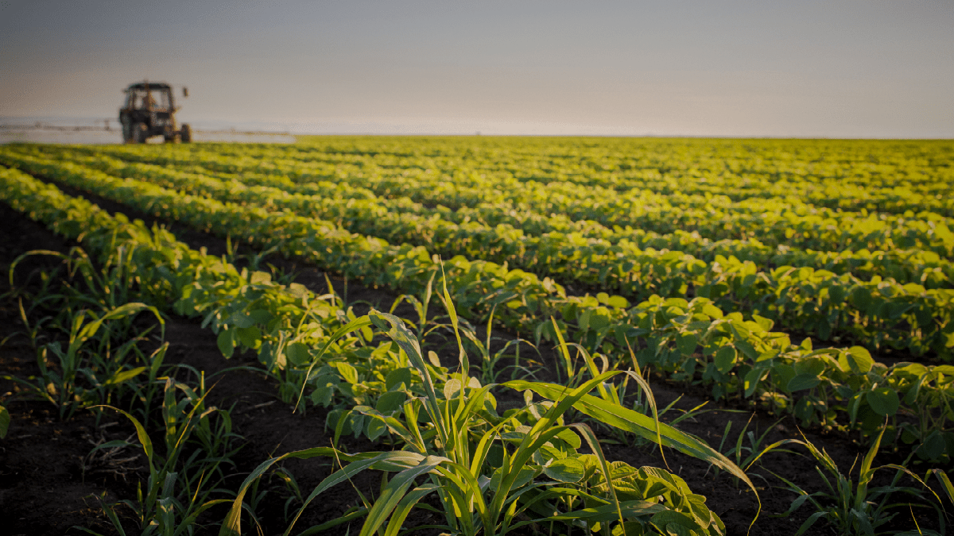
Introduction
This project of aims to conduct a comprehensive analysis of Indian agriculture, focusing on district-wise and year-wise data. The dataset provides detailed information on various crops, their areas, production, and yields across different districts and years. The goal is to leverage Power BI to create interactive visualizations that uncover trends, patterns, and disparities in agricultural practices, enabling stakeholders to make informed decisions for sustainable farming and resource allocation.

Slide 4
Dataset Overview
The dataset consists of the following key matrices:
District Code, District Name
State Code, State Name
Year (1996 – 2017)
AREA (1000 ha), PRODUCTION (1000 tons), YIELD (Kg per ha) value of the following Crops: Rice, Wheat, Kharif Sorghum, Rabi Sorghum, Pearl Millet, Finger Millet, Maize, Barley Chickpea, Pigeon pea, Minor Pulses, Groundnut, Sesamum, Rapeseed, Castor, Safflower, Linseed, Sunflower, Soyabean, Oilseed, Sugarcane, Cotton
Only AREA (1000 ha) value for: Fruits, vegetable, Fruits & Vegetables, Onion, Potatoes, Fodder

Slide 5
Objective for Analysis
Explore the dataset to understand the distribution of agricultural variables across districts and years.
Crop Yield trends of the major crops like Rice, Wheat, Pulses across regions.
Seasonal patterns and variability impact of climate change on crop production
Analyze the cultivation trends of fruits, vegetables, and their overall contribution to agricultural practices.
Dataset Manipulations Made for Analysis
Summation of Area column, Production column, Yield column of Minor Pulses, Chickpea, Pigeon pea under Pulses category for analysis of trends of major crops.
Summation of Area columns of all the major crop areas under Total Area category.
Summation of Production columns of all the major crop productions under Total Production category.
Summation of Yield columns of all the major crop yields under Total yield category.

Slide 6
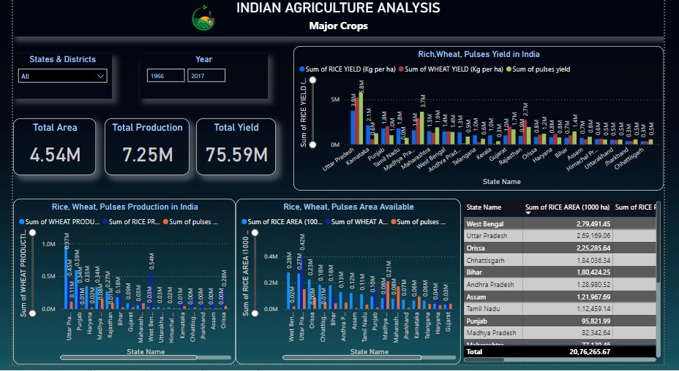
Power BI Report 1 - Major Crops

Slide 7
Key Findings – Major Crops
Category | Area | Production | Yield
Major Crops | Highest: Uttar Pradesh Lowest: Himachal Pradesh | Highest: Uttar Pradesh Lowest: Himachal Pradesh | Highest: Uttar Pradesh Lowest: Chhattisgarh
Rice | Highest: West Bengal Lowest: Himachal Pradesh | Highest: West Bengal Lowest: Himachal Pradesh | Highest: Uttar Pradesh Lowest: Chhattisgarh
Wheat | Highest: Uttar Pradesh Lowest: Kerala | Highest: Uttar Pradesh Lowest: Kerala | Highest: Uttar Pradesh Lowest: Kerala
Pulses | Highest: Madhya Pradesh Lowest: Kerala | Highest: Madhya Pradesh Lowest: Kerala | Highest: Uttar Pradesh Lowest: Kerala
In the last 10 years Kerala does not seem to show any significant rise in the production of the major Crops
In the last 10 years Madhya Pradesh has seen rise in the production of Pulses
The top 5 area suitable for growth of major crops are: Uttar Pradesh, Madhya Pradesh, Rajasthan, Punjab, Maharashtra.
The top 5 producers of major crops are: Uttar Pradesh, Punjab, Madhya Pradesh, West Bengal, Haryana
The top 5 states with the highest yield of major crops are: Uttar Pradesh, Madhya Pradesh, Rajasthan, Gujarat, Punjab

Slide 8
Seasonal Crops
1. Kharif Crops:
Crops that grow during summer are called Kharif crops. They are sown at the beginning of the rainy season around June and are harvested around October.
Rice cultivation is highly dependent on water availability, with both excess water (flooding) and water scarcity (drought) posing challenges. Excessive rainfall can lead to waterlogging and crop damage, while drought conditions can reduce yields. It is also sensitive to temperature and Humidity.
Sugar cane requires consistent moisture throughout its growth period. However, excessive rainfall can lead to waterlogging and root rot, while drought conditions can reduce cane sucrose content and yield. It is also sensitive to temperature and Sunlight.
2. Rabi Crops:
The agricultural crops that are sown in winter and harvested in the spring.
Wheat is sensitive to temperature variations during key growth stages.
Wheat cultivation typically requires well-distributed rainfall and adequate sunlight for photosynthesis.
Kharif Crops |  | Rabi Crops
Rice Maize Finger Millets Pearl Millets Pigeon Pea Ground Nut | Sesaum Safflower Soybean Cotton Sugarcane Kharif Sorghum | Wheat Barley Chickpea Minor Pulses(lentils) Rapseed & Mustard | Linseed Sunflower Rabi Sorghum Castor

Slide 9
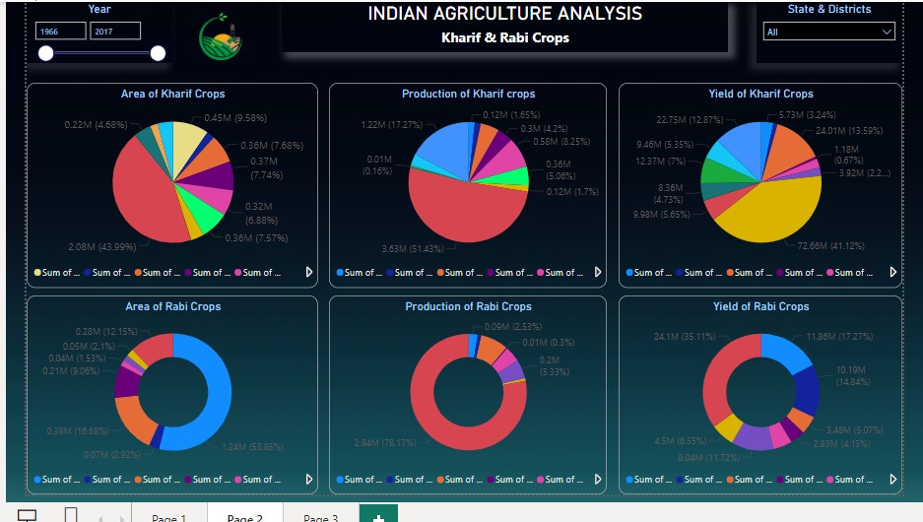
Power BI Report 2 – Seasonal crops

Slide 10
Key Findings – Seasonal Crops
Category | Area | Production | Yield
Rabi Crops (Highest Count) | Wheat – 53.85%, Chickpea – 16.58 % , Rabi Sorghum – 12.15% contribution w.r.t all other rabi crops. | Wheat – 78.17%, Chickpea – 7.75 % ,contribution w.r.t all other rabi crops. | Wheat – 35.11%, Barley – 17.27% ,Chickpea – 14.84 % , Rapeseed & Mustard– 11.27% contribution w.r.t all other rabi crops.
Rabi Crops (Lowest Count) | Castor – 1.53% , Linseed – 1.71%, Sunflower – 2.1% contributor to the total count. | Sunflower – 0.68%, Linseed – 0.3%, Castor – 0.95% contributor to the total count. | Sunflower – 5.31%, Linseed – 9.13%, Castor – 5.07% contributor to the total count.
Kharif Crops (Highest Count) | Rice – 43.99%, Cotton – 9.58 % contribution w.r.t all other Kharif crops. | Rice – 51.43%, Sugar Cane – 17.29 % contribution w.r.t all other Kharif crops. | Sugar Cane – 41.12 %, Rice – 13.59% contribution w.r.t all other Kharif crops.
Kharif Crops (Lowest Count) | Sesamum – 2.09%, Finger Millet – 2.14% contributor to the total count. | Finger Millet – 1.63%, Cotton – 1.65% contributor to the total count. | Safflower– 0.67%, Cotton – 1.14% contributor to the total count.
Cotton being among the crops having the highest area has the least yield
Rice being the staple food has the highest production and yield followed by sugar cane
Wheat being the staple food has the highest area, production and yield

Slide 11
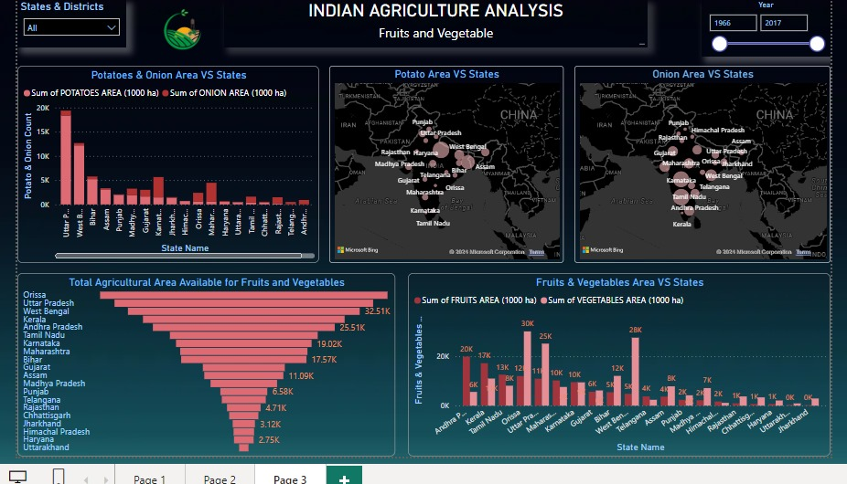
Power BI Report 3 – Fruits & Vegetables

Slide 12
Key Findings – Fruits & Vegetables
Crops | State (Area)
Potato | Highest: Uttar Pradesh, West Bengal, Bihar, Assam Lowest: Kerala, Andhra Pradesh, Telangana, Rajasthan, Chhattisgarh, Tamil Nadu
Onion | Highest: Karnataka, Maharashtra, Orissa, Gujarat, Madhya Pradesh Lowest: Kerala, Chhattisgarh, Assam, Punjab, Himachal Pradesh
Fruits & Vegetables | Highest: Orissa, Uttar Pradesh, West Bengal, Kerala, Andhra Pradesh Lowest: Uttarakhand, Haryana, Himachal Pradesh, Jharkhand, Chhattisgarh
Vegetable | Highest: Telangana, Orissa, Uttar Pradesh
Fruits | Highest: Andhra Pradesh, Kerala, Tamil Nadu, Orissa

Slide 13

Sustainable Farming Insights
1. Crop Selection and Rotation:
Recognize the disparity between crop area and yield, such as cotton having high area but low yield. Encourage farmers to diversify crops and consider rotating low-yield crops like cotton with more productive alternatives to improve overall yield and income stability.
Promote the cultivation of crops like rice, sugar cane, and wheat, which have high production and yield. However, ensure sustainable practices are adopted to maintain soil fertility and prevent environmental degradation.
2.. Resource Allocation:
Rice being the staple food has the highest production and yield followed by sugar cane and wheat also being the staple food has the highest area, production and yield. So effective measures should be taken for the proper distribution of these crops throughout the country.
3. Regional Suitability Assessment:
There is a significant parity in the areas where potato and onion is grown. Potato is grown in north eastern regions whereas onion is grown in southern region as shown in the map. This understanding can guide farmers and policymakers in selecting crops based on local climatic and soil conditions.
Orissa is well suited for both fruits and vegetable growth and is the major contributor for fruits and vegetable growth. This region could serve as a focal point for agricultural development initiatives aiming to enhance production and diversify crop varieties.

Slide 14
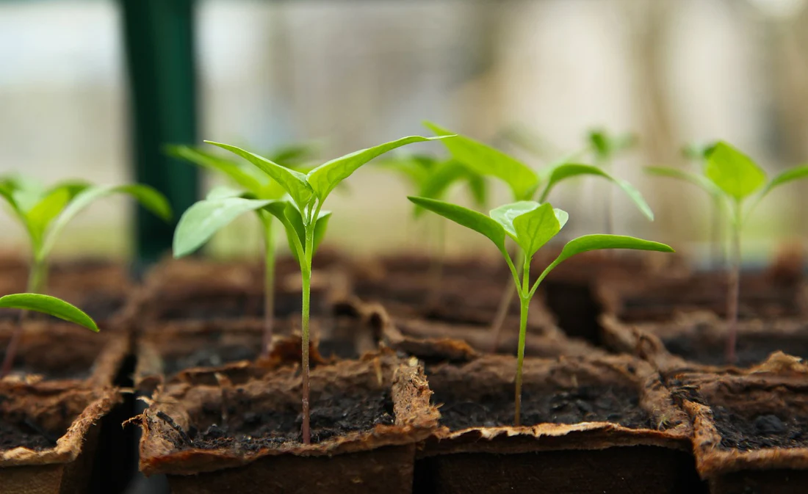
Sustainable Farming Insights
4. Targeted Support Programs:
Kerala is better suited for fruits compared to vegetable growth. So, farmers can focus support on fruit cultivation practices and market access.
In the last 10 years West Bengal shows a significant growth in the vegetable table growth taking the top position, but for fruits, it is quite less. So, interventions could target improving fruit cultivation techniques and addressing barriers to fruit market access.
5. Promotion of Crop Diversification:
In the last 10 years Andhra Pradesh, Kerala, Tamil Nadu, Orissa retains its spot for having the highest are for fruits growth. Encourage crop diversification efforts which can enhance resilience to market fluctuations and climate variability.

Slide 15
Conclusion
In this project, we harnessed the capabilities of Power BI to conduct a comprehensive analysis of major crops across various states in India. By leveraging data visualization and analytics, we gained insights into seasonal fluctuations and trends affecting crop production. Additionally, we conducted a detailed examination of fruit and vegetable cultivation patterns nationwide. Moreover, we delved into sustainable farming practices, aiming to enhance yield while efficiently managing resources for long-term agricultural sustainability and resilience in India.

Slide 16
THANK YOU

